Slide 1


Telecom Churn

Slide 2
Team Members
Mentor’S
Pavan Kumar
Dilavar
Poojashree
Akash
Mounika
Suraj
Vikranta Desai
Sudhakar

Slide 3
Business Problem & Objective :
Customer churn is a big problem for telecommunications companies. Indeed, their annual churn rates are usually higher than 10%. For that reason, they develop strategies to keep as many clients as possible. This is a classification project since the variable to be predicted is binary (churn or loyal customer). The goal here is to model churn probability, conditioned on the customer features.

Slide 4
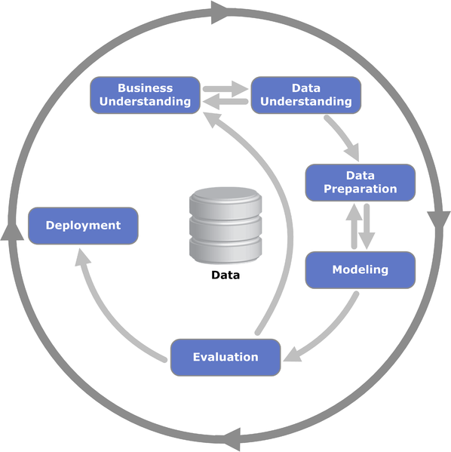
Project Architecture / Project Flow

Slide 5
Data set details:
Each row corresponds to a client of a telecommunications company for whom it has collected information about the type of plan they have contracted, the minutes they have talked, or the charge they pay every month.
state: Categorical, for the 51 states and the District of Columbia.
Area.code
account.length: how long the account has been active.
voice.plan: yes or no, voicemail plan.
voice.messages: number of voicemail messages.
intl.plan: yes or no, international plan.
intl.mins: minutes customer used service to make international calls.
intl.calls: total number of international calls.
intl.charge: total international charge.

Slide 6
day.mins: minutes customer used service during the day.
day.calls: total number of calls during the day.
day.charge: total charge during the day.
eve.mins: minutes customer used service during the evening.
eve.calls: total number of calls during the evening.
eve.charge: total charge during the evening.
night.mins: minutes customer used service during the night.
night.calls: total number of calls during the night.
night.charge: total charge during the night.
customer.calls: number of calls to customer service.
churn: Categorical, yes or no. Indicator of whether the customer has left the company (yes or no).

Slide 7
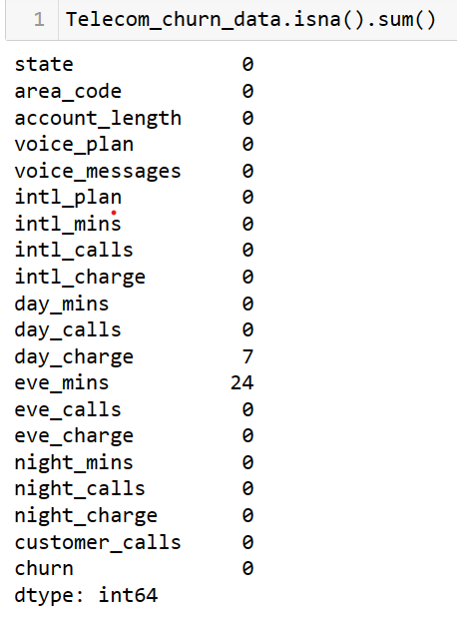
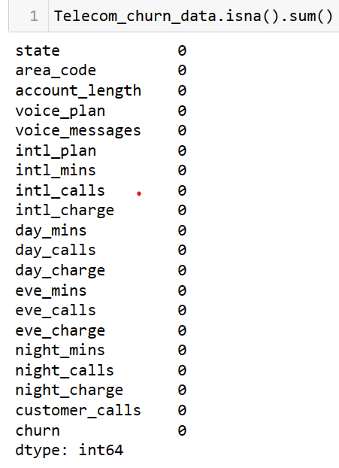
Statistical Analysis :
We can see that 24 Null Values in eve_mins and 7 Null values in Day_Charge
Imputed Null values with Median.

Slide 8
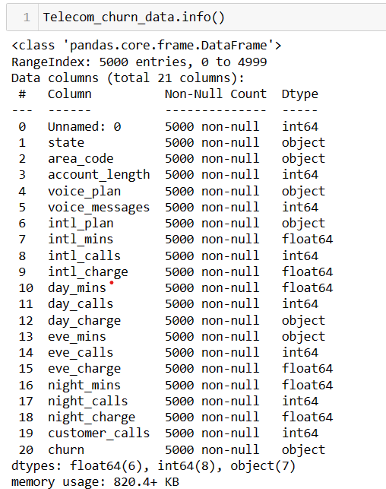
We can observe Day mins and Eve Mins Dtype is object. By looking data Manually data is numerical data.
So, we have convert into float.

Slide 9
Exploratory Data Analysis (EDA) and
Feature Engineering

Slide 10
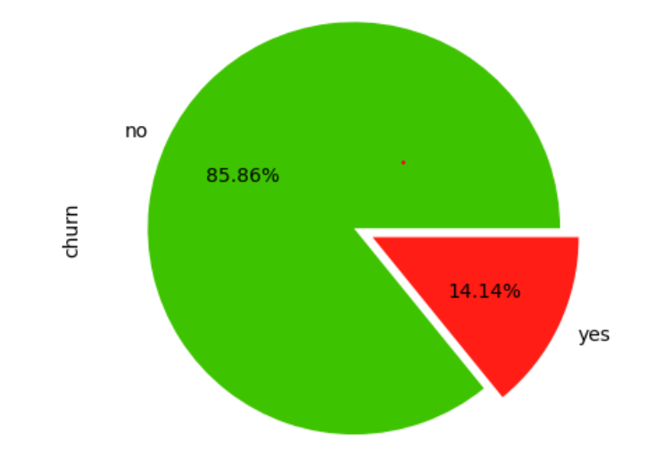
Exploratory Data Analysis (EDA)
85.86% has No churn and 14.14% has churn through out Dataset.

Slide 11
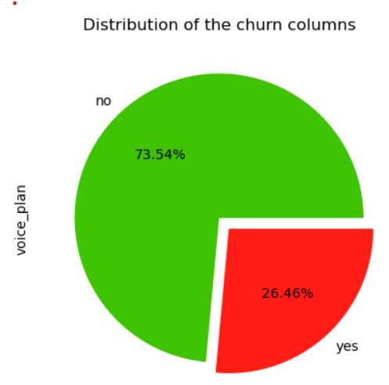
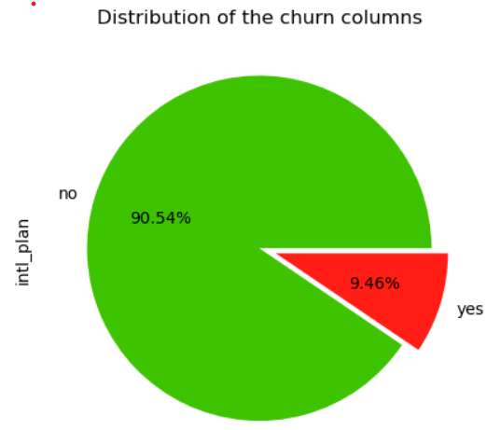
EDA
73.54% has No churn and 26.46% has churn who has taken Voice Plan.
90.54% has No churn and 90.54% has churn who has taken international plan.

Slide 12
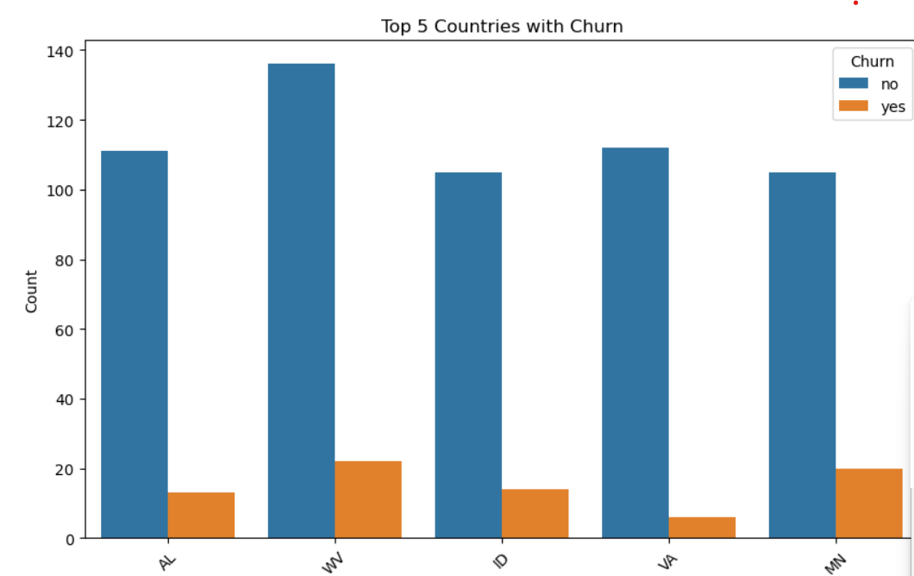
Top 5 countries Churn Details

Slide 13
Feature Engineering:
Feature Importance using Decision Tree:
Top 8 Features :
1.day_mins
2.day_charge
3.customer_calls
4.eve_mins
5.eve_charge
6..intl_calls
7.intl_plan
8.intl_mins
Recursive Feature Elimination:
top 8 Features are:
1.voice_plan
2.voice_messages
3. intl_plan
4.intl_charge
5.day_mins
6.day_charge
7.eve_charge
8. customer_calls
By Using both Feature Importance using Decision Tree & Recursive Feature Elimination. We have selected top 8 features from both technique and make a New Dataframe. By using New data frame we can build the model.

Slide 14
Model Building

Slide 15
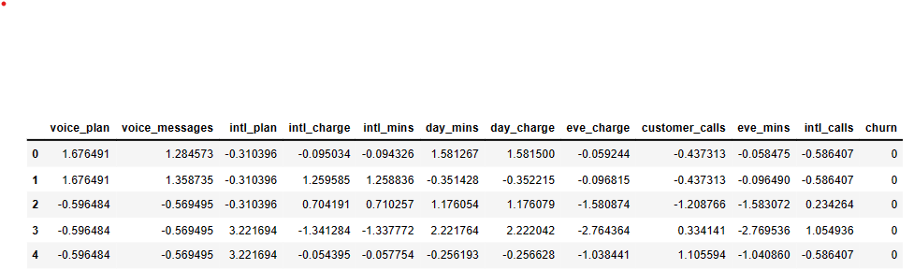
Dataset for model Building :

Slide 16
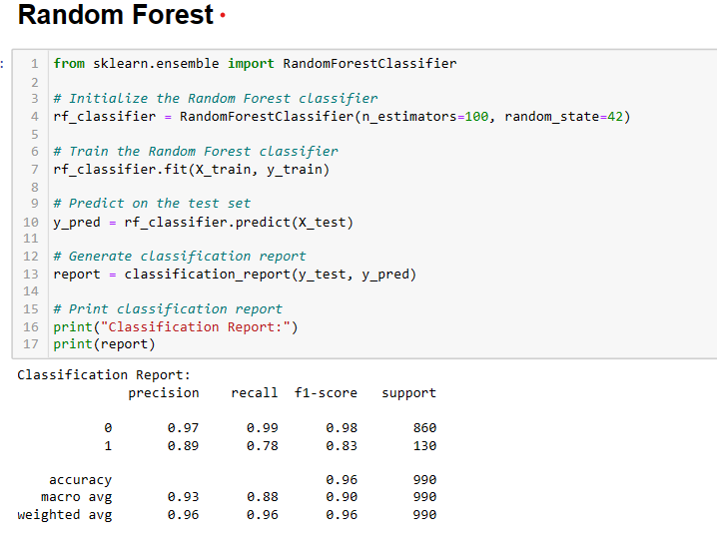
Model : RandomForestClassifier()

Slide 17
Model Deployment using Streamlit
App Url : http://localhost:8501/

Slide 18
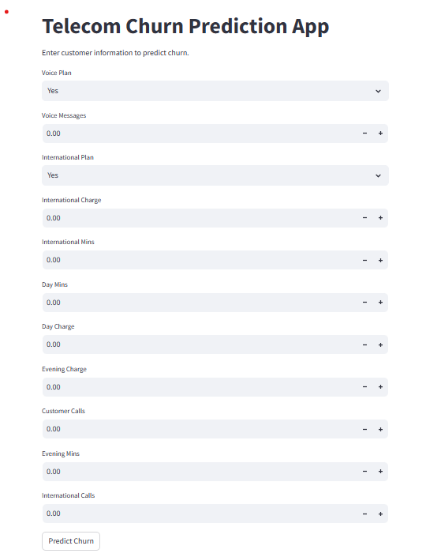

Slide 19
Conclusion:
Churn prediction is an ongoing process that requires continuous monitoring and optimization. We recommend establishing a feedback loop to regularly evaluate the effectiveness of retention strategies and refine predictive models based on new data and changing market conditions.

Slide 20
Thank you

